Slide 1
Scientific Programming with C++
Use of 3rd party libraries in research

Slide 2
Learning objectives
After this lecture and related assignments, you will…
Have an idea of how source code turns into usable programs
Have an idea of how libraries work in C++
Be introduced to the inclusion of 3rd party libraries in your programs

Slide 3
Introduction: source code to computer programs (1/2)
C++ projects consist of ”translation units” that must be compiled
Source code we wrote
Source code we included
The compiler creates object code files (.obj) from translation units
Human-readable source code to machine-readable object code
In our project, just from our code
Code we included is already available as .obj (.o on Unix)
The linker links together different (compiled) object code files
Allows the use of e.g. the C++ standard library
Creates the final executable file (or a library)

Slide 4
Introduction: source code to computer programs (2/2)
Two programs involved
The compiler
Source code to object code
The linker
Connects object code files to create the executable
Object code and executables are not portable on different operating systems

Slide 5
Libraries
What is a library?
Source code that others have written for our use
An archive of object files created by the linker
Examples
C++ standard library
You have been using this
3rd party libraries
The C++ standard library has many great general functionalities
But research work often requires very specialized classes
Only found in 3rd party libraries

Slide 6
Using libraries
If you have the full source code
You can compile the source code of the library with your source code
If you have the library as a header and static or shared/dynamic library file
You need to link the library to your program’s object code
Static libraries are packed into your executable
Results in one big file
Dynamic libraries are referenced to your executable at build time
But used at program run time
Results in a not-so-big executable and a separate dynamic library file (which may be shared by multiple different programs)

Slide 7
Why use 3rd party libraries?
Solving research problems often involves complex and chained calculations
Solving the activation levels of muscles during walking from trajectories of motion capture markers
Creation of a subject-specific musculoskeletal model, calculation of joint angles, calculation of joint moments based on the angles, estimation of muscle activity given the muscle parameters…
Predicting future values in a time series based on previous known values
Choosing and training a prediction model, testing on an independent test set to evaluate prediction accuracy, predicting from real-world data
And so forth
Implementing the computations involved yourself would take a long time
Using 3rd party libraries with existing algorithms for the problem saves time

Slide 8
Installing 3rd party libraries
Somewhat inconvenient as there is no universal dependency manager like in Python
For interesting discussion, see for example
“Why is it such an abysmal pain to use libraries in C++ compared to pretty much anything else?”
https://www.reddit.com/r/cpp/comments/ix9n1u/why_is_it_such_an_abysmal_pain_to_use_libraries/
“C++ libraries are impossible to install”
https://www.reddit.com/r/cpp/comments/ozg80h/c_libraries_are_impossible_to_install/
Adapting a 3rd party library usually involves
1. Downloading the library
2. Configuring your project to be able to find the library and link relevant library files (often with helper programs)
3. Troubleshooting, changing some configuration parameters and trying again

Slide 9
dlib
We will use dlib (http://dlib.net/)
“Dlib is a modern C++ toolkit containing machine learning algorithms and tools for creating complex software in C++ to solve real world problems.“
Relatively easy to install for many headers
No need to explicitly link libraries
No need for external programs to configure projects in IDE
“In most cases, to use this library all you have to do is extract it somewhere, make sure the folder containing the dlib folder is in your include path, and finally add dlib/all/source.cpp to your project. “
http://dlib.net/compile.html, “Compiling C++ examples without CMake”

Slide 10
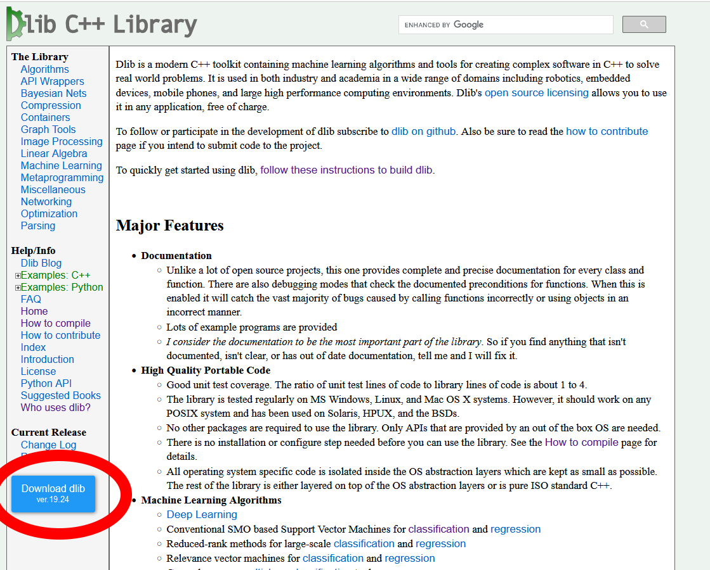
Configuring dlib on Windows & Visual Studio
Download dlib from the website
Extract the zipped package on your hard drive

Slide 11
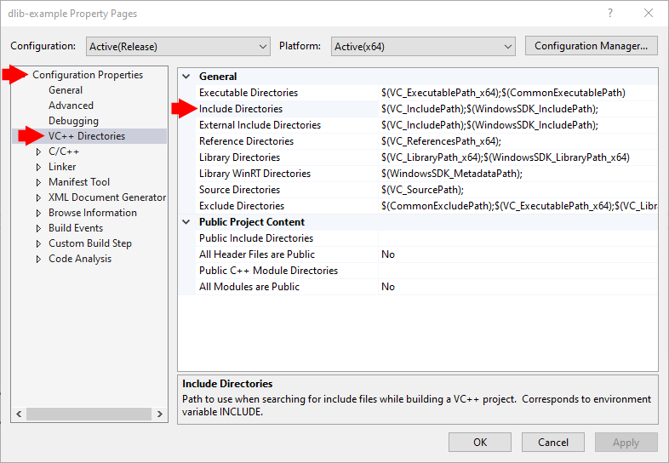
Configuring dlib on Windows & Visual Studio
Download dlib from the website
Extract the zipped package on your hard drive
Create a new project in Visual Studio
Set include directories
“make sure the folder containing the dlib folder is in your include path”

Slide 12
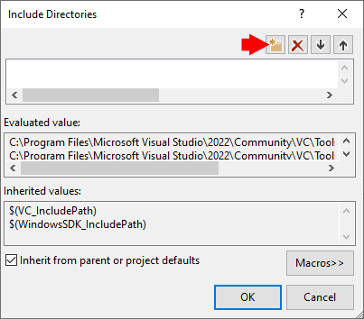
Configuring dlib on Windows & Visual Studio
Download dlib from the website
Extract the zipped package on your hard drive
Create a new project in Visual Studio
Set include directories
“make sure the folder containing the dlib folder is in your include path”

Slide 13
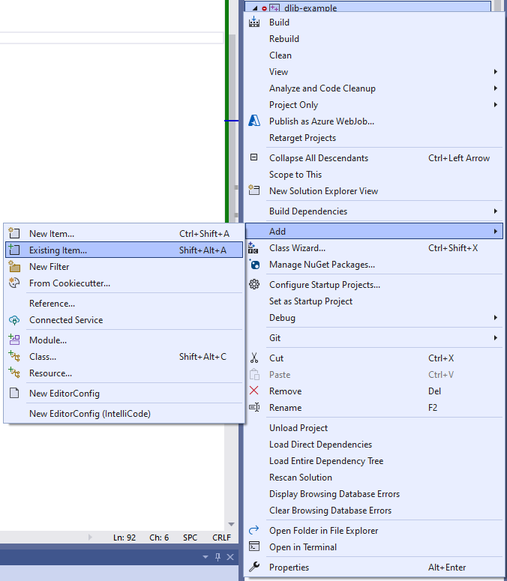
Configuring dlib on Windows & Visual Studio
Download dlib from the website
Extract the zipped package on your hard drive
Create a new project in Visual Studio
Set include directories
“make sure the folder containing the dlib folder is in your include path”
Add dlib/all/source.cpp to your project
Project -> Add -> Existing Item…

Slide 14
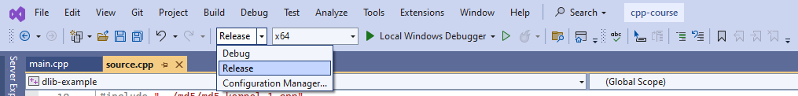
Configuring dlib on Windows & Visual Studio
If building the project fails, make sure solution configuration is “Release”
fatal error C1128: number of sections exceeded object file format limit: compile with /bigobj

Slide 15
Configuring dlib on Windows & Visual Studio
In your own .cpp file, include the relevant headers
You should now be able to use dlib in your own code
If not, refer to the documentation (http://dlib.net/compile.html)
#include "C:/Users/StudentMcStudentson/Downloads/dlib-19.24/dlib/mlp.h"
#include "C:/Users/StudentMcStudentson/Downloads/dlib-19.24/dlib/clustering.h"
#include "C:/Users/StudentMcStudentson/Downloads/dlib-19.24/dlib/matrix.h"

